Slide 1

Universal Application Development on Windows Platform for Beginners Module 1.2: XAML Controls
Dmitry Soshnikov
dmitryso@microsoft.com | twitter.com/shwars | blog.soshnikov.com
Microsoft

Slide 2
XAML Syntax
Tags with Attributes
<TextBlock Text=“Hello, World!”/>
Default Attributes
<TextBlock>Hello, World!</TextBlock>
Detailed Attribute Definition (can contain other tags)
<TextBlock>
<TextBlock.Text>
Hello, World!
</TextBlock.Text>
</TextBlock>

Slide 3
Some Useful XAML Controls
Containers
Simple Elements
StackPanel
Grid
Canvas
TextBlock
TextBox
Image
Button
CheckBox
ComboBox
Collections
Tricky Elements
ItemsControl
ListBox
GridView / ListView
Hub
Pivot
DatePicker
TimePicker
Rectangle
Ellipse
MediaElement

Slide 4
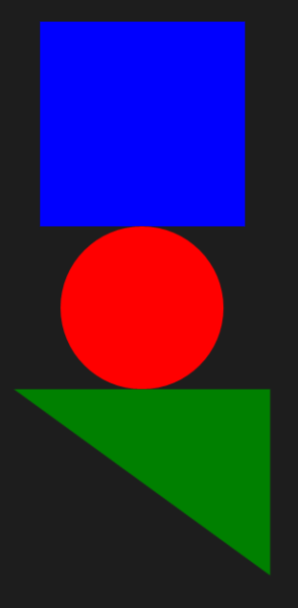
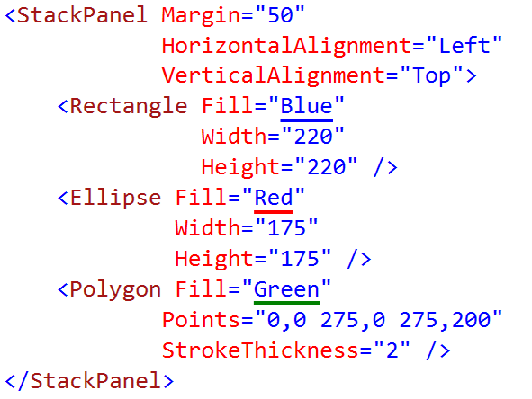
StackPanel
StackPanel can be used for vertical, as well as for horizontal (Orientation=“Horizontal”) layout.

Slide 5
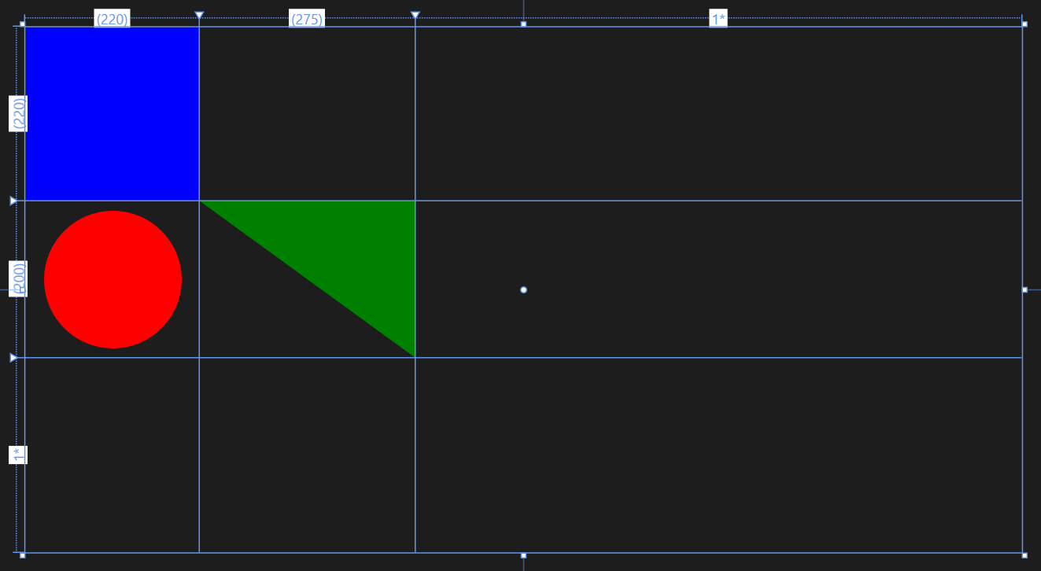
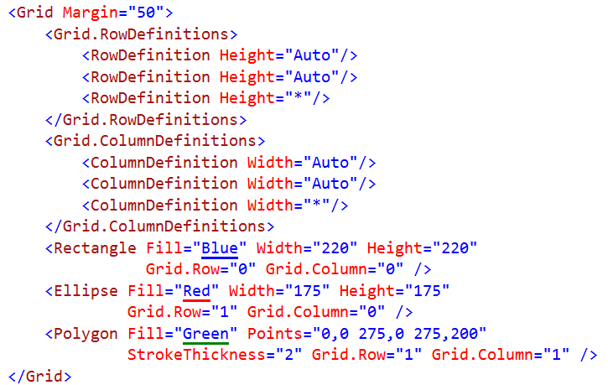
Grid
Sized in Grid can be specified using Auto, stretchable (*), or absolute size in pixels. Placement of the child element is determined by its Grid.Row/Column attributes.

Slide 6
DEMO 03: Data Entry Form

Slide 7
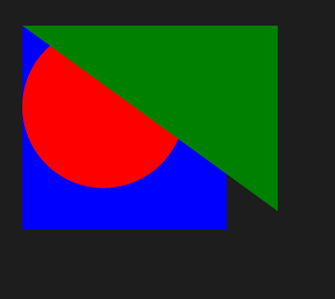
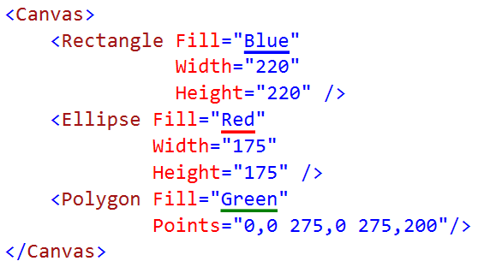
Canvas
Canvas allows you to individually position each element using Left/Top attribute in XAML or Canvas.SetLeft/SetTop functions in the code-behind (C#)

Slide 8
DEMO 04: Moving Circle

Slide 9
Flyout Elements
<Popup IsOpen="" />
<ContentDialog Title="" Content="" />
<Flyout Placement="" />
<MenuFlyout />
<ToolTip />

Slide 10
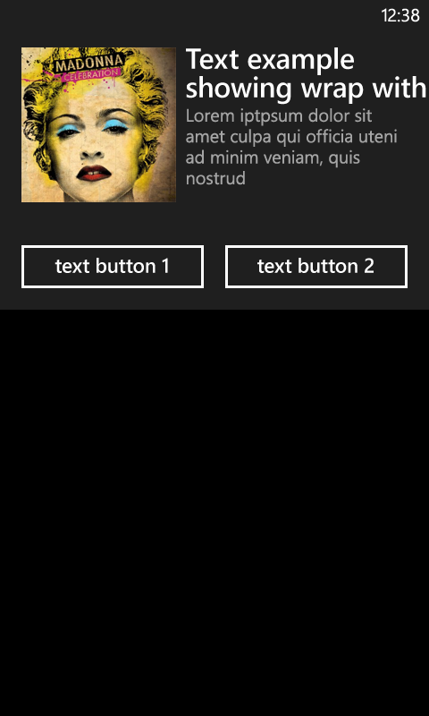
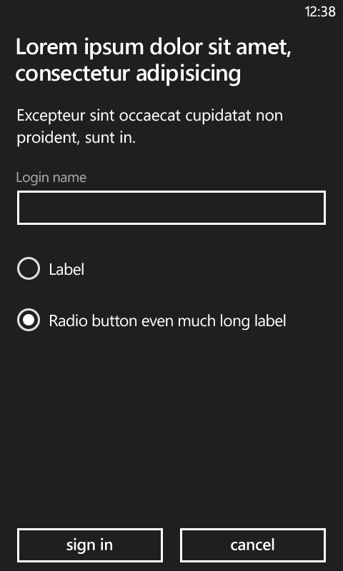
ContentDialog

Slide 11
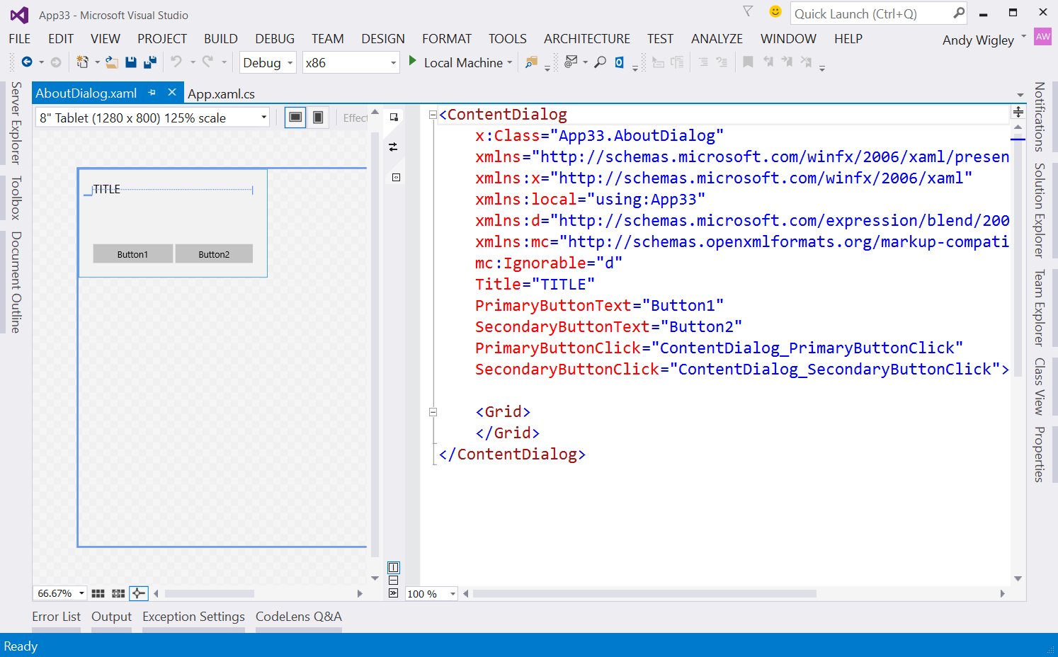
ContentDialog
Project -> ‘Add New Item’ -> ContentDialog
ContentDialog is laid out in XAML as a separate page
To show, use the following code:
AboutMessage myDialog = new AboutMessage();
ContentDialogResult result = await myDialog.ShowAsync();
if (result == ContentDialogResult.Primary) { /* do some more Primary logic */ }
else if (result == ContentDialogResult.Secondary)
{ /* else do Secondary logic */ }

Slide 12
Conclusion
XAML gives you wide variety of controls
Containers automatically lay out elements on a page
We can position elements arbitrarily, and thus we are ready to make games!
In the real life, XAML is rarely used for games, because XAML Layout engine is not using hardware acceleration, and thus is not very performant

Slide 13

Contact
Dmitry Soshnikov
Microsoft
dmitryso@microsoft.com & vk.com/shwars
blogs.msdn.com/sos & blog.soshnikov.com
twitter: @shwars

